Slide 1

Conversation engine for deaf and dumb using IBM Watson
Team members:
G.Gayathri
CH.Swetha sree
Lavanya
Vineesha
Kalyani
(Geethanjali college of engineering&technology)

Slide 2

INTRODUCTION
In our society, we have people with disabilities. The technology is developing day by day but no significant developments are undertaken for the betterment of these people. About nine billion people in the world are deaf and dumb. Communications between deaf-mute and a normal person has always been a challenging task. It is very difficult for mute people to convey their message to normal people. Since normal people are not trained on hand sign language. In emergency times conveying their message is very difficult.

Slide 3
The human hand has remained a popular choice to convey information in situations where other forms like speech cannot be used. Voice Conversion System with Hand Gesture Recognition and translation will be very useful to have a proper conversation between a normal person and an impaired person in any language.

Slide 4
AIM OF THE PROJECT
The project aims to develop a system that converts the sign language into a human hearing voice in the desired language to convey a message to normal people, as well as converting speech into understandable sign language for the deaf and dumb. We are making use of a convolution neural network to create a model that is trained on different hand gestures. An app is built which uses this model. This app enables deaf and dumb people to convey their information using signs which get converted to human-understandable language and speech is given as output.

Slide 5
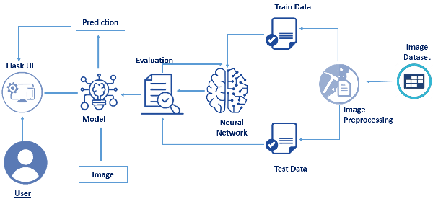
Architecture:

Slide 6
Pre-requisites
To complete this project, you must require the following software’s, concepts, and packages: Anaconda (IDLE / Spyder / PyCharm)(Python 3.7)
Python Packages
Tensorflow- This package is used as backend support to Keras
Keras-This package is used for building Neural Network layers
OpenCV-This package is used for image processing
Flask- To build a web application

Slide 7
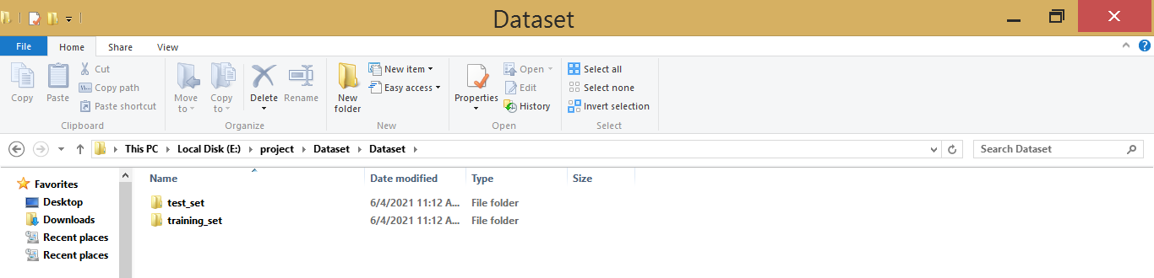
Data Collection
In this, we will be collecting data for building our project. We will be creating two folders one for training and the other for testing. Images present in the training folder will be used for building the model and the testing images will be used for validating our model. A minimum of 100 images needs to be present in each category folder to get the maximum no of features.

Slide 8
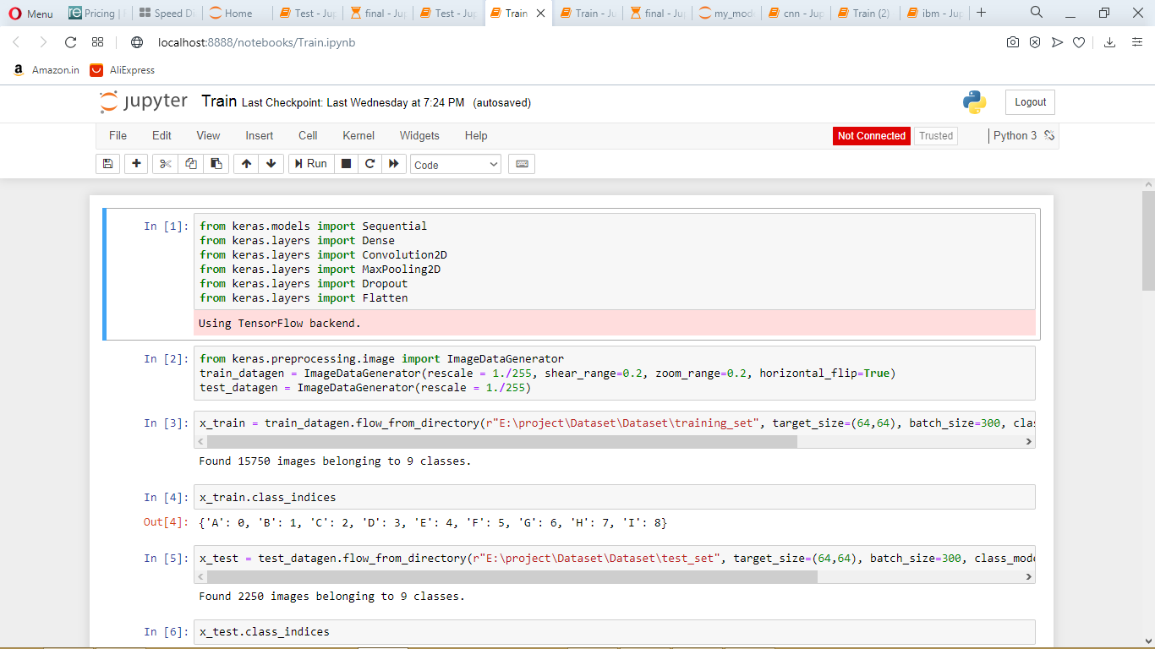
Image Preprocessing
In this, we will pre-process the images which will be used for building the model. Image pre-processing includes zooming, shearing, flipping to increase the robustness of the model after it is built. We will be using the Keras package for pre-processing images.

Slide 9
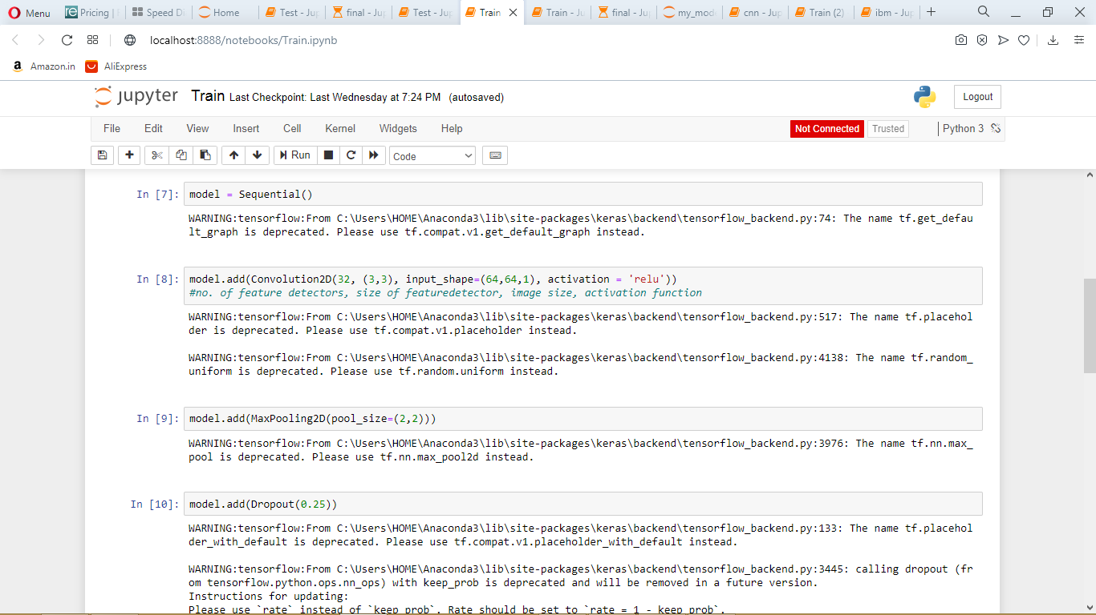
Model Building

Slide 10
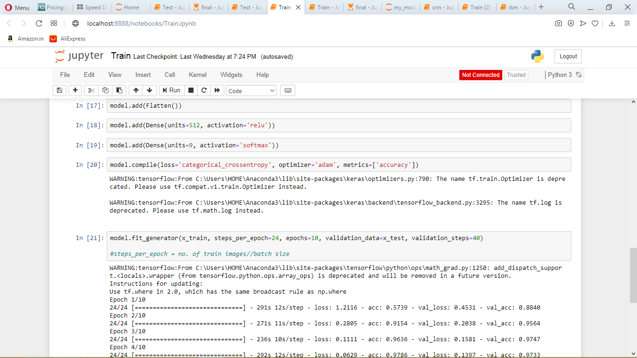

Slide 11
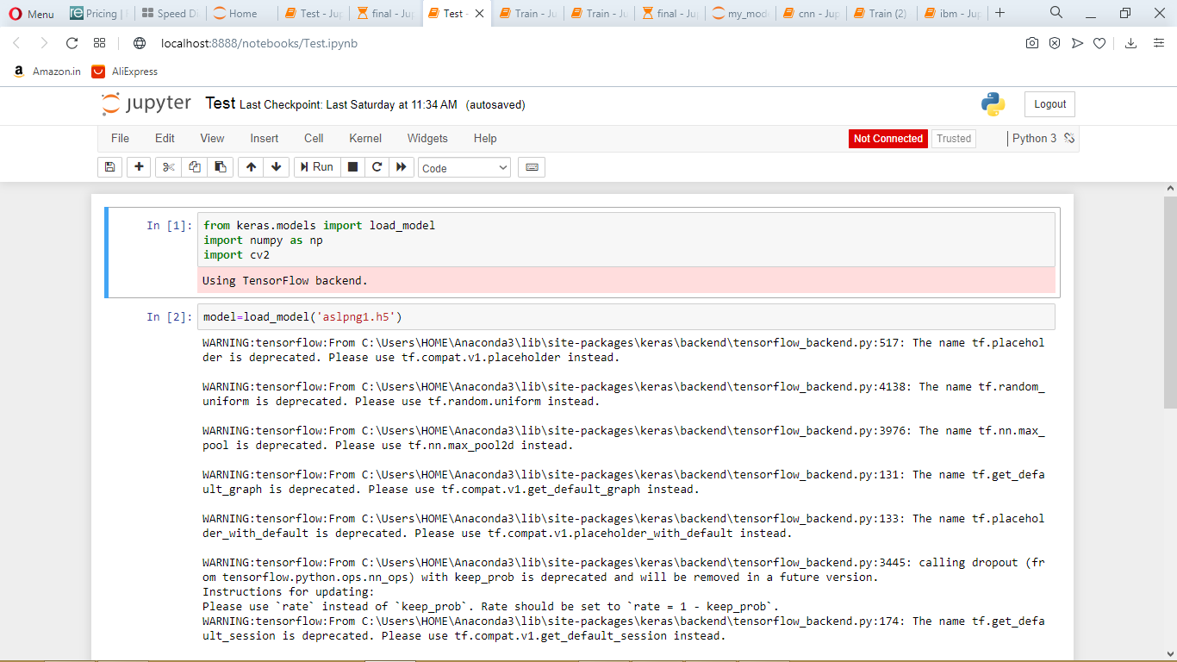
Test the model
Now we test the model by passing an image to get predictions. While test the model we should make sure that the test image should meet the target size of the model, dimensions need to meet, and should undergo rescaling before giving it to the model.

Slide 12
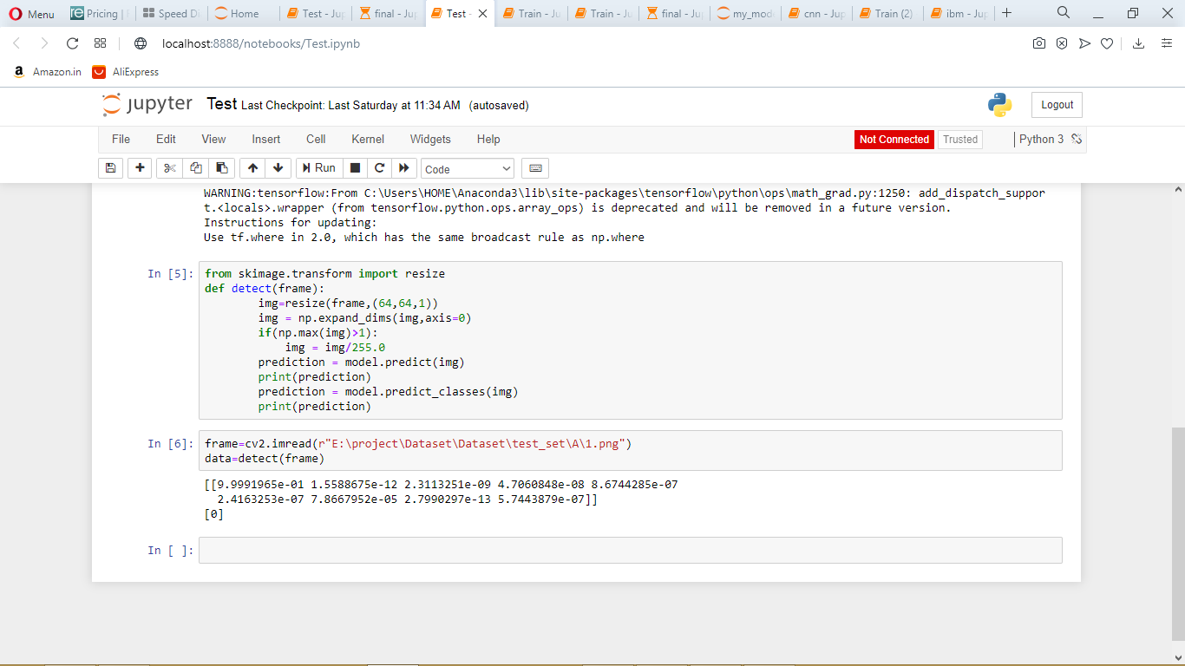

Slide 13
Application Building
Now we will be building a Flask application that is used for building our UI which in backend can be interfaced to the model to get predictions. Flask application requires an HTML page for Frontend and a Python file for the backend which takes care of the interface with the model.

Slide 14
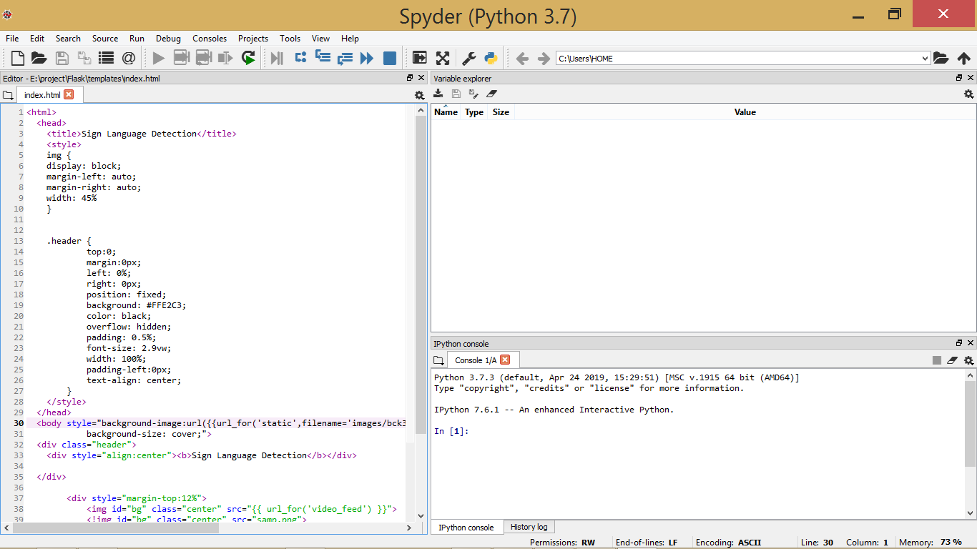
HTML FILE

Slide 15
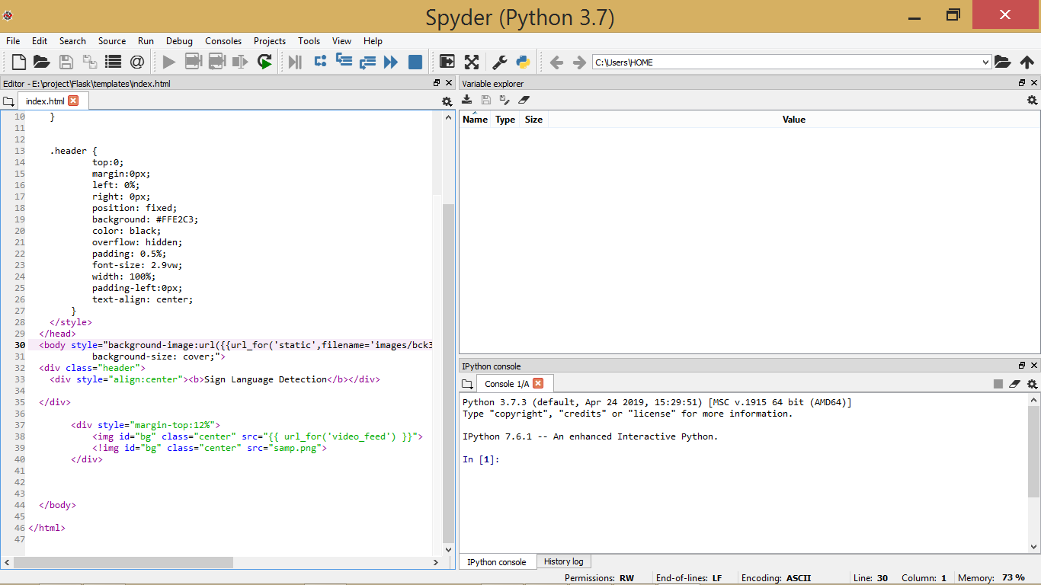

Slide 16
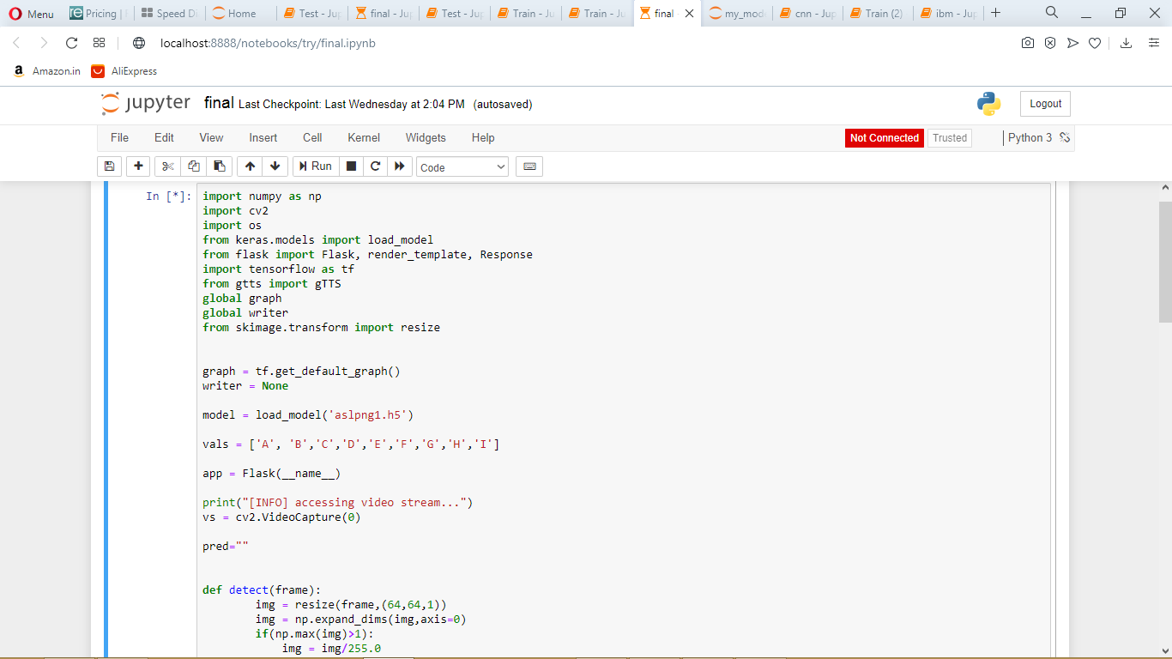
PYTHON FILE:

Slide 17
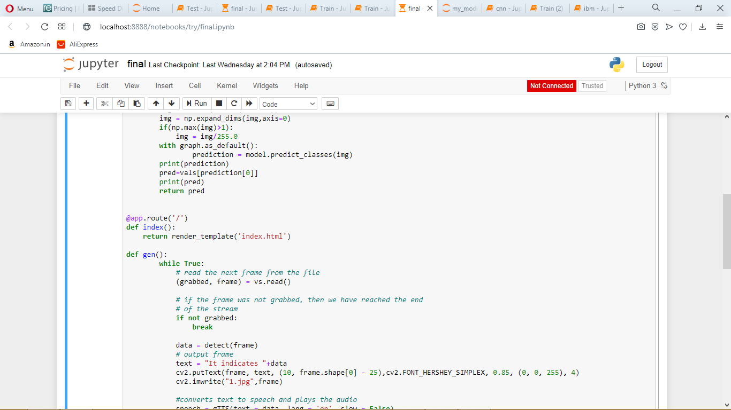

Slide 18
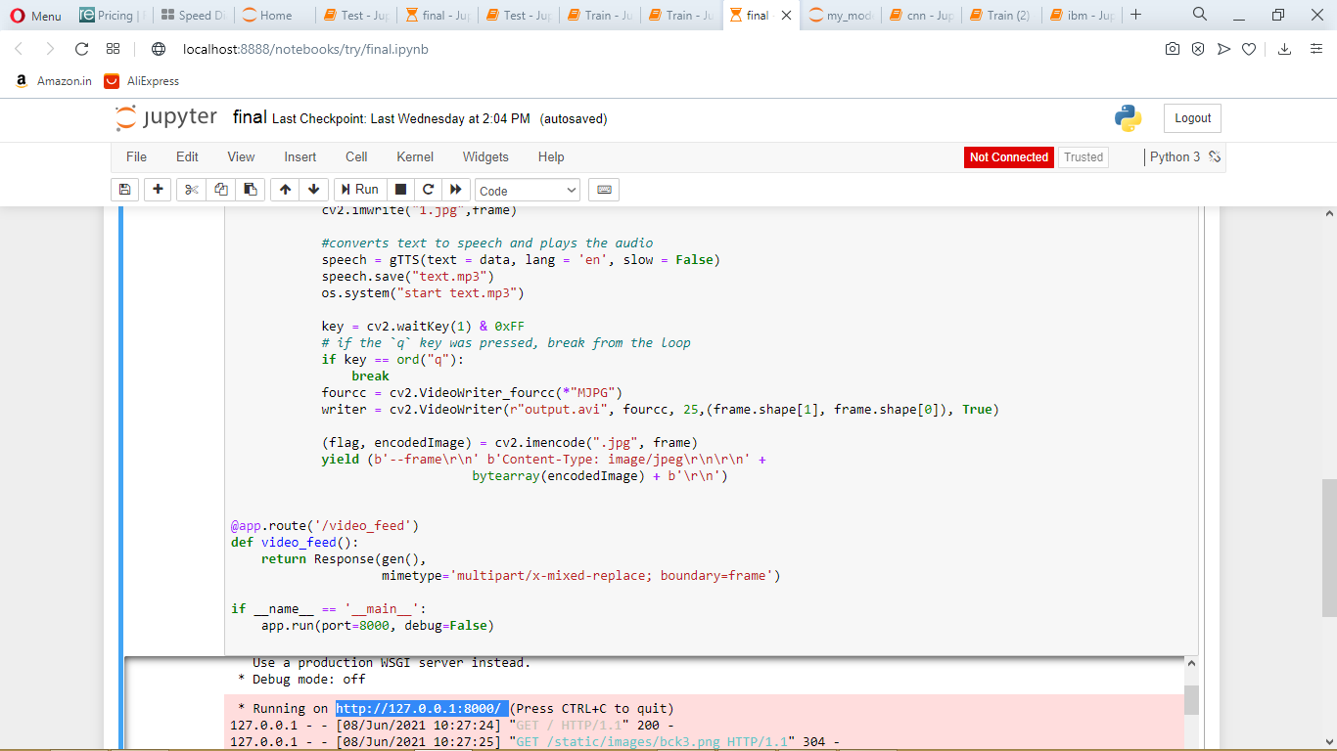
This is the local host

Slide 19
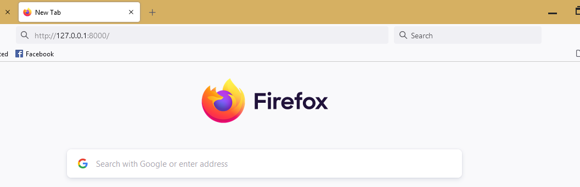
Output We open the browser and navigate to localhost:8000 to check your application.

Slide 20
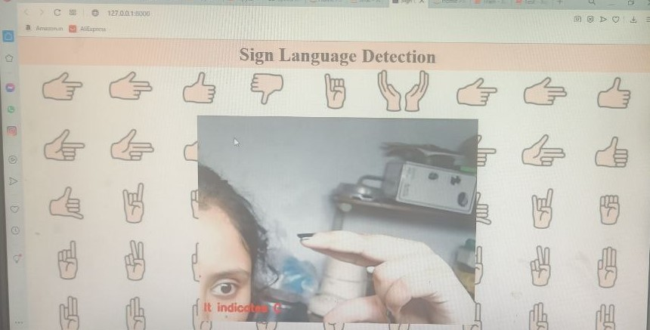

Slide 21
We have also trained the same model on IBM Cloud using IBM Watson Studio Service.
THANK YOU

